Slide 1
Maximizing Software Development Investments
Productivity, Reliability, Portability, and Performance
David Burggraaf
Microsoft Visual C++

Slide 2
C/C++ & Java in Academia
Q: What programming language do you use most often?
Base: Students taking CS/CE/MIS Courses
Source: Internal Microsoft Research
C/C++ Java
US 46% 28%
Germany 37% 45%
India 81% 8%
Japan 35% 27%
Notes:
C++ skills required in workforce.
Never hired, nor known of anyone hired with just Java or C# experience alone.
C++ is the required language for upper level courses in CS.

Slide 3
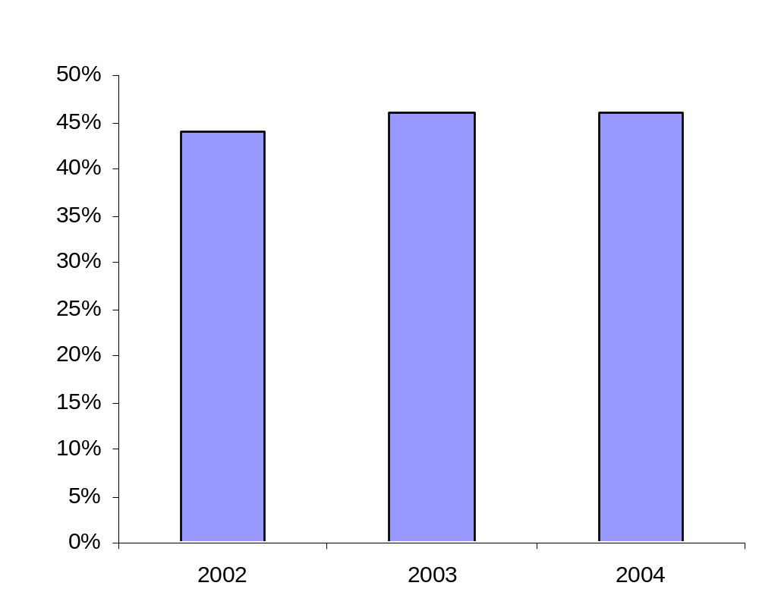
C++ Academic Trends
US CS/CE/MIS Students
Question: What programming language do you use most often?
Base: Students taking CS/CE/MIS courses
Source: Internal Microsoft Research

Slide 4
C++ Future

Slide 5
C++
Systems Programming
Notes:
Broadest Platforms
Windows, Unix, Embedded, etc.

Slide 6
C++
Application Programming
Notes:
Primary language used by the world’s top ISVs. Microsoft, Oracle, Adobe, Autodesk, Intuit, etc.

Slide 7
C++ Programming Paradigms
Notes:
Multi-Paradigm
Functional, OO, Generic, Generative, Managed, Verifiable, Distributed

Slide 8
Language

Slide 9
Choosing a Language
Q: Which language should you use?
Microsoft’s answer, in our Whidbey release:
  C++ is the recommended path to .NET and Longhorn.
  If you have an existing C++ code base:
  Keep using C++.
  If you want to make frequent use of native code/libs:
  Use C++. It’s far simpler (seamless) and faster.
  If you want to write brand-new pure-.NET apps that rarely or never interop with native code:
  Use whatever language you’re already comfortable with, and pick based on language features. The .NET features and Frameworks library are available equally through all languages.

Slide 10
PowerPoint.NET
Notes:
Show process explorer.

Slide 11
2002/3: Managed Extensions
2004/5: C++ in Whidbey
  Deterministic cleanup, destructors.
  Templates.
  Native types.
  Multiple inheritance.
  STL, generic algorithms, lambda expressions.
  Pointer/pointee distinction.
  Copy construction, assignment.
  Garbage collection, finalizers.
  Generics.
  Reference and value types.
  Interfaces.
  Verifiability.
  Security.
  Properties, delegates, events.
C++ CLR

Slide 12
Storage and Pointer Model
Create objects on the native heap, CLR (gc) heap, or on the stack:
  On the native heap (native types): T* t1 = new T;
    As usual, pointers (*) are stable, even during GC.
    100% backward compatible with all standard and nonstandard stupid pointer tricks.
    As usual, failure to explicitly call delete will leak.
  On the gc heap (CLR types): T^ t2 = gcnew T;
    Handles (^) are object references (to whole objects).
    Calling delete is optional: "Destroy now, or finalize later.“
  On the stack, or as a class member: T t3;
    Q: Why would you? A: Deterministic destruction/dispose is automatic and implicit, hooked to stack unwinding or to the enclosing object’s lifetime.

Slide 13
Boxing (Value Types)
Boxing is implicit and strongly typed:
  int^ i = 42; // strongly typed boxed value
  Object^ o = i; // usual derived-to-base conversions ok
  Console::WriteLine( "Two numbers: {0} {1}", i, 101 );
  i is emitted with type Object + attribute marking it as int.
  WriteLine chooses the Object overload as expected.
  Boxing invokes the copy constructor.
Unboxing is explicit:
  Dereferencing a V^ indicates the value inside the box, and this syntax is also used for unboxing:
  int k = *i; // unboxing to take a copy
  int% i2 = *i; // refer into the box (no copy)
  swap( *i, k ); // swap contents of box with stack variable
  // (no copy, modifies the contents of box)

Slide 14
Aside: Agnostic templates
To demonstrate the unification, consider agnostic templates.
Example 1: Usual swap, with % instead of &.
  template<class T>
  void swap( T% t1, T% t2 )
  { T tmp( t1 ); t1 = t2; t2 = tmp; }
  Works for any copyable T:
  Object ^o1, ^o2; swap( o1, o2 ); // swap handles
  int ^i1, ^i2; swap( i1, i2 ); // swap handles
  swap( *i1, *i2 ); // swap values
  MessageQueue *q1, *q2; swap( q1, q2 ); // swap pointers
  swap( *q1, *q2 ); // swap values
  ref class R { } r1, r2; swap( r1, r2 ); // swap values*
  value class V { } v1, v2; swap( v1, v2 ); // swap values
  class Native { } n1, n2; swap( n1, n2 ); // swap values*
  * assuming copy construction/assignment are defined

Slide 15
T::~T()
destroy now
or
T:: !T()
finalize later

Slide 16
Side By Side: Using a StreamReader
  C++ String^ ReadFirstLineFromFile( String^ path ) {
  StreamReader r(path);
  return r.ReadLine();
  }
  C# String ReadFirstLineFromFile( String path ) {
  using ( StreamReader r = new StreamReader(path) ) {
  return r.ReadLine();
  }
  }
  Java String ReadFirstLineFromFile( String path ) {
  StreamReader r = null;
  String s = null;
  try {
  r = new StreamReader(path);
  s = r.ReadLine();
  } finally {
  if ( r != null ) r.Dispose();
  }
  return s;
  }

Slide 17
Side By Side: Using “lock”
  C++ {
  lock l( obj );
  … do something with shared state …
  }
  C# lock( obj ) {
  … do something with shared state …
  }
  Java Monitor.Enter( obj );
  try {
  … do something with shared state …
  } finally {
  Monitor.Exit( obj );
  }

Slide 18
Side By Side: Nontrivial “lock”
  C++ {
  lock l( obj, 10 );
  … do something with shared state …
  }
  C# if( !Monitor.TryEnter( obj, TimeSpan.FromSeconds( 10 ) ) ) {
  throw new Something();
  }
  try {
  … do something with shared state …
  } finally {
  Monitor.Exit( obj );
  }
  Java if( !Monitor.TryEnter( obj, TimeSpan.FromSeconds( 10 ) ) ) {
  throw new Something();
  }
  try {
  … do something with shared state …
  } finally {
  Monitor.Exit( obj );
  }

Slide 19
Side By Side: Nontrivial “lock”
  C++ {
  lock l( obj, 10 );
  … do something with shared state …
  }
  C# using( new Lock( obj, 10 ) ) {
  … do something with shared state …
  }
  public class Lock
  : IDisposable {
  private object target;
  public Lock(
  object o, double tm
  ) {
  target = o;
  if( !Monitor.TryEnter( o, tm ) )
  throw new Something();
  }
  void IDisposable.Dispose() {
  Monitor.Exit( target );
  #if DEBUG
  GC.SuppressFinalize( this );
  #endif
  }
  #if DEBUG
  ~Lock() {
  Diagnostics.Debug.Fail(
  "Undisposed lock“
  );
  }
  #endif
  }

Slide 20
Deterministic Cleanup in C++
C++ example:
  void Transfer() {
  MessageQueue source( "server\\sourceQueue" );
  String^ qname = (String^)source.Receive().Body;
  MessageQueue dest1( "server\\" + qname ),
  dest2( "backup\\" + qname );
  Message^ message = source.Receive();
  dest1.Send( message );
  dest2.Send( message );
  }
  On exit (return or exception) from Transfer, destructible/ disposable objects have Dispose implicitly called in reverse order of construction. Here: dest2, dest1, and source.
  No finalization.

Slide 21
Deterministic Cleanup in C#
Minimal C# equivalent:
  void Transfer() {
  using( MessageQueue source
  = new MessageQueue( "server\\sourceQueue" ) ) {
  String qname = (String)source.Receive().Body;
  using( MessageQueue
  dest1 = new MessageQueue( "server\\" + qname ),
  dest2 = new MessageQueue( "backup\\" + qname ) ) {
  Message message = source.Receive();
  dest1.Send( message );
  dest2.Send( message );
  }
  }
  }

Slide 22
Deterministic Cleanup in VB/Java
Minimal Java equivalent:
  void Transfer() {
  MessageQueue source = null, dest1 = null, dest2 = null;
  try {
  source = new MessageQueue( "server\\sourceQueue" );
  String qname = (String)source.Receive().Body;
  dest1 = new MessageQueue( "server\\" + qname );
  dest2 = new MessageQueue( "backup\\" + qname );
  Message message = source.Receive();
  dest1.Send( message );
  dest2.Send( message );
  }
  finally {
  if( dest2 != null ) { dest2.Dispose(); }
  if( dest1 != null ) { dest1.Dispose(); }
  if( source != null ) { source.Dispose(); }
  }
  }

Slide 23
Deterministic Cleanup in C++ (2)
C++ example with polymorphism:
  void Transfer() {
  auto_hnd<Object> source =
  gcnew MessageQueue( "server\\sourceQueue" );
  // …
  }
C++ example with for other than Dispose:
  void Transfer() {
  auto_close<FileStream> source =
  gcnew FileStream( “myfile”, … );
  // …
  }

Slide 24
Basic Class Declaration Syntax
Type are declared “adjective class”:
  class N { /*…*/ }; // native
  ref class R { /*…*/ }; // CLR reference type
  value class V { /*…*/ }; // CLR value type
  interface class I { /*…*/ }; // CLR interface type
  enum class E { /*…*/ }; // CLR enumeration type
  C++ & CLR fundamental types are mapped to each other (e.g., int and System::Int32 are the same type).
Examples:
  ref class A abstract { }; // abstract even w/o pure virtuals
  ref class B sealed : A { }; // no further derivation is allowed
  ref class C : B { }; // error, B is sealed

Slide 25
Properties
Basic syntax:
  ref class R {
  int mySize;
  public:
  property int Size {
  int get() { return mySize; }
  void set( int val ) { mySize = val; }
  }
  };
  R r;
  r.Size = 42; // use like a field; calls r.Size::set(42)
Trivial properties:
  ref class R {
  public:
  property int Size; // compiler-generated
  }; // get, set, and backing store

Slide 26
Indexed Properties
Indexed syntax:
  ref class R { // …
  map<String^,int>* m;
  public:
  property int Lookup[ String^ s ] {
  int get() { return (*m)[s]; }
  protected:
  void set( int ); // defined out of line below
  }
  property String^ default[ int i ] { /*…*/ }
  };
  void R::Lookup::set( String^s, int v ) { (*m)[s] = v; }
Call point:
  R r;
  r.Lookup["Adams"] = 42; // r.Lookup[“Adams”].set(42)
  String^ s = r[42]; // r.default[42].get()

Slide 27
Delegates and Events
A trivial event:
  delegate void D( int );
  ref class R {
  public:
  event D^ e; // trivial event; compiler-generated members
  void f() { e( 42 ); } // invoke it
  };
  R r;
  r.e += gcnew D( this, &SomeMethod );
  r.e += gcnew D( SomeFreeFunction );
  r.f();
Or you can write add/remove/raise yourself.

Slide 28
Virtual Functions and Overriding
Explicit, multiple, and renamed overriding:
  interface class I1 { int f(); int h(); };
  interface class I2 { int f(); int i(); };
  interface class I3 { int i(); int j(); };
  ref class R : I1, I2, I3 {
  public:
  virtual int e() override; // error, there is no virtual e()
  virtual int f() new; // new slot, doesn’t override any f
  virtual int f() sealed; // overrides & seals I1::f and I2::f
  virtual int g() abstract; // same as “= 0” (for symmetry
  with class declarations)
  virtual int x() = I1::h; // overrides I1::h
  virtual int y() = I2::i; // overrides I2::i
  virtual int z() = j, I3::i; // overrides I3::i and I3::j
  };
Notes:
“virtual” is required, except for cases where ISO C++ doesn’t require it

Slide 29
Delegating Constructors
Can delegate to one peer constructor.
No cycle detection is required.
  ref class R {
  S s;
  T t;
  R( int i, const U& u ) : s(i), t(u) { /* init */ }
  public:
  R() : R( 42, 3.14 ) { }
  R( int i ) : R( i, 3.14 ) { }
  R( U& u ) : R( 53, u ) { }
  };

Slide 30
CLR Enums
Three differences:
  Scoped.
  No implicit conversion to underlying type.
  Can specify underlying type (defaults to int).
  enum class E1 { Red, Green, Blue };
  enum class E2 : long { Red, Skelton };
  E1 e1 = E1::Red; // ok
  E2 e2 = E2::Red; // ok
  e1 = e2; // error
  int i1 = (int)Red; // error
  int i2 = E1::Red; // error, no implicit conversion
  int i3 = (int)E1::Red; // ok

Slide 31
Generics × Templates
Both are supported, and can be used together.
Generics:
  Run-time, cross-language, and cross-assembly.
  Constraint based, less flexible than templates.
  generic<typename T>
  where T : IDisposable, IFoo
  ref class GR { /* … */ };
  Constraints are inheritance-based.
Templates:
  Compile-time, C++, and generally intra-assembly.
  Not a high burden: expose templates through generic interfaces (e.g., expose a_container<T> via IList<T>).
  Supports specialization, unique power programming idioms (e.g., template metaprogramming, policy-based design,
  STL-style generic programming).

Slide 32
STL on the CLR
C++ enables STL on CLR:
  Verifiable.
  Separation of collections and algorithms.
Interoperates with Frameworks library.
C++ “for_each” and C# “for each” both work:
  stdcli::vector<String^> v;
  for_each( v.begin(), v.end(), functor );
  for_each( v.begin(), v.end(), _1 += “suffix” ); // C++
  for_each( v.begin(), v.end(), cout << _1 ); // lambdas
  g( %v ); // call g( IList<String^>^ )
  for( String^ s in v ) Console::WriteLine( s );

Slide 33
Other Features
Param arrays:
  Created when needed, preferred over varargs
  void f( String^ str, ... array<Object^>^ arr );
  f( “Hello”, “world”, 42 );
Unified CLR and C++ operators:
  Operators can now be static. Most work on handles.
  ref class R { public: // ...
  static R^ operator+( R^ lhs, R^ rhs );
  };
  Equality tests reference identity. Can be overridden by user.
XML doc comments.

Slide 34
Verifiability and CLS
Compiler-enforceable verifiability:
  Use /clr:safe.
  Tools available to enforce CLS signatures (FxCop).
Easier to write verifiable code:
  * and & are never verifiable.
  ^ and % are always verifiable.

Slide 35
C++/CLI Participants and Timeline
Participants:
  Convener: Tom Plum
  Project Editor: Rex Jaeschke
  Subject Matter Experts: Bjarne Stroustrup, Herb Sutter
  Participants: Dinkumware, EDG, IBM,
  Microsoft, Plum Hall…
  Independent conformance test suite: Plum Hall
Ecma + ISO process, estimated timeline:
  Oct 1, 2003: Ecma TC39 plenary. Kicked off TG5.
  Nov 21, 2003: Submitted base document to Ecma.
  Dec 2003 – Sep 2004: TG5 meetings (7).
  Dec 2004: Vote on whether to adopt as Ecma standard.
  Q1 2005: If successful, submit for ISO fast-track process.
  Q1 2006: If ready, vote on whether to adopt ISO standard.

Slide 36
Productivity

Slide 37
Design
Notes:
Class designers
WinForms designers
MFC desigeners
Webservices
Database

Slide 38
Browsing
Notes:
Class/function browsers – incremental search/filtering
Caller/callee browsing
Source definition window

Slide 39
Building
Notes:
Project templates.
Multiproc builds
Extensible including custom UI settings
Create from existing.

Slide 40
MFC
WinForms
Avalon/Indigo/WAP
Integration

Slide 41
Performance

Slide 42
Profile Guided Optimizations

Slide 43
MSIL Optimizations

Slide 44
Quake II
Notes:
Gradients, Rotation, Transparency, etc.

Slide 45
Integrated Profiling

Slide 46
Smallest To Fastest
Notes:
Watches, SmartPhone, CE, to 64bit

Slide 47
Security

Slide 48
Secure CRT

Slide 49
Compile-time Checks

Slide 50
Runtime Checks

Slide 51
Code Coverage

Slide 52
Summary
C++/CLI
  Standardization, templates, generics, deterministic destruction, pure, verifiable, etc.
Industry leading IDE
  Browsing, editing, debugging, stability
  Build: style sheets, multiproc builds, multi-platform support
  Designers: Class, WebService, Winforms, Data
Compiler
  Security checks, OpenMP, Profile guided optimization, optimized MSIL, advanced static analysis, 64 bit support
Libraries
  Secure CRT, .NET/Winforms integration
Misc.
  Integrated CE Experience, Profiling

Slide 53
PrintShop

Slide 54
For More Information
http://msdn.microsoft.com/visualc/
Blogs:
  Brandon Bray http://blogs.msdn.com/branbray
  Herb Sutter http://blogs.msdn.com/hsutter
  Stan Lippman http://weblogs.asp.net/slippman
  Jonathan Caves http://joncaves.blogspot.com
  Martyn Lovell http://blogs.gotdotnet.com/martynl
C++/CLI Draft Specification
  http://msdn.microsoft.com/visualc/homepageheadlines/ecma/default.aspx

Slide 55
Visual C++
David Burggraaf
http://msdn.microsoft.com/visualc
dburg@microsoft.com

